Slide 1
INSE 6120 - Cryptographic Protocols and Network Security
Ethereum Smart Contract
NAME
Shivam Patel
Ekta Patel
Jay Patel
Dhwanil Patel
Aashika Lakhani

Slide 2
INTRODUCTION

Slide 3
Smart Contracts
Smart contracts are self-executing contracts with the terms of the agreement directly written into code.
Smart contracts are designed to eliminate the need for intermediaries, such as lawyers or banks, to oversee the performance of a contract.
Smart contracts are typically associated with blockchain technology, but they can be implemented on any digital platform.
Because smart contracts are executed automatically by the code, they can reduce the risk of errors and fraud that can occur with traditional contracts.
However, smart contracts are still subject to coding errors or malicious attacks, which can result in the loss of assets or other negative consequences.

Slide 4
Ethereum Smart Contract
Self-executing programs that run on the Ethereum blockchain.
Ethereum blockchain and can be programmed to automatically execute when certain conditions are met.
Ethereum is a decentralized blockchain platform that enables the creation of smart contracts and decentralized applications (DApps).
Mostly, Smart contracts on Ethereum are programmed using a high-level programming language called Solidity.
A smart contract becomes immutable once it is deployed on the Ethereum blockchain, which implies that it cannot be modified in any way.

Slide 5
PROGRAMMING LANGUAGES

Slide 6

Solidity
Solidity is a high-level programming language that is designed specifically for writing smart contracts on the Ethereum blockchain.
It is similar to JavaScript and C++ in syntax, and supports object-oriented programming features such as inheritance, polymorphism, and interfaces.
It is compiled into bytecode that can be executed on the Ethereum Virtual Machine (EVM), which is a decentralized, tamper-proof virtual machine that runs on every node in the Ethereum network.

Slide 7
Solidity
PROS
Solidity is the most widely used programming language for Ethereum smart contracts, and has a large community of developers who contribute to its development and improvement.
Solidity is a highly flexible language that can be used to write complex smart contracts with sophisticated functionality.
Solidity is similar to JavaScript and C++ in syntax, which makes it easier for developers who are familiar with these languages to learn and use.

Slide 8
Solidity
CONS
Smart contracts written in Solidity are vulnerable to security issues such as reentrancy attacks and integer overflow/underflow.
Solidity can be complex, especially for developers who are not familiar with object-oriented programming or the Ethereum blockchain.
Solidity smart contracts can be difficult to audit, which can lead to security vulnerabilities and bugs.

Slide 9

Vyper
High-level programming language that is designed specifically for writing secure smart contracts on the Ethereum blockchain.
It was designed to address some of the security vulnerabilities and complexities of Solidity.
Vyper has a syntax that is similar to Python, but is more restrictive in terms of features in order to make it easier to write secure and auditable smart contracts.

Slide 10
Vyper
PROS
Vyper is designed with security as a top priority, with features like static analysis and formal verification built in to help identify potential security vulnerabilities.
Vyper has a simpler syntax than Solidity, which can make it easier for developers to write and audit smart contracts.
Vyper is designed to be more gas-efficient than Solidity, which can help reduce the cost of deploying smart contracts on the Ethereum blockchain.

Slide 11
Vyper
CONS
Vyper is a relatively new language compared to Solidity, and has a smaller community of developers. This means that there are fewer resources and libraries available for Vyper compared to Solidity.
Vyper has a more restricted feature set compared to Solidity, which means that it may be less flexible in terms of the types of smart contracts that can be developed.
While some developers may find the Python-like syntax of Vyper easier to work with, others may prefer the more familiar C-like syntax of Solidity.
Developers who are new to Vyper may need to invest more time in learning the language compared to Solidity, which has more resources and documentation available.

Slide 12
YUL
YUL (previously also called JULIA or IULIA) is a low-level programming language for the Ethereum Virtual Machine (EVM) which is more simplistic and functional.
It is designed to be more efficient and flexible than other languages like EVM bytecode or Solidity.

Slide 13
YUL
PROS
YUL is designed to be a more efficient way to write code for the EVM, as it provides more direct control over the bytecode generated by the compiler. This can lead to faster execution times and lower gas costs.
YUL supports a wide range of low-level operations and data types, which makes it suitable for writing complex contracts or optimizing performance-critical code.
YUL can be used alongside other Ethereum languages like Solidity, which means that developers can use it for specific parts of their contracts while still leveraging the features of other languages.

Slide 14
YUL
CONS
YUL is a low-level language, which means that it can be more difficult to write and debug than higher-level languages like Solidity or Vyper. Developers will need to have a good understanding of the EVM and the low-level details of smart contract execution in order to use YUL effectively.
There are currently fewer resources and tutorials available for it compared to more established Ethereum languages like Solidity.
YUL has fewer tools and libraries available compared to other Ethereum languages, which can make it more difficult to develop and test smart contracts.

Slide 15
YUL+
YUL+ is an extension of the YUL language, which is a low-level language for the Ethereum Virtual Machine
YUL+ is an extension of the YUL language, which is a low-level language for the Ethereum Virtual Machine

Slide 16
YUL+
PROS
YUL+ is designed to provide even more control and flexibility over the generated bytecode compared to YUL. This can lead to even greater efficiency and lower gas costs for smart contracts.
YUL+ includes additional safety features like automatic memory management and type checking, which can help prevent common security vulnerabilities like buffer overflows or integer overflows.

Slide 17
YUL+
CONS
YUL+ is a low-level language, which means that it can be more difficult to write and debug than higher-level languages like Solidity or Vyper. Developers will need to have a good understanding of the EVM and the low-level details of smart contract execution in order to use YUL+ effectively.
It is a more specialized language that may not be as suitable for developers who are new to Ethereum or who are looking for a higher-level language with more robust tooling and support.

Slide 18
VULNERABILITIES

Slide 19
RE-ENTRANCY
Re-entrancy attacks are a type of security vulnerability in Ethereum smart contracts that allow attackers to repeatedly call a function in a contract before the original call has completed.
Re-entrancy attacks can lead to unexpected behaviors or outcomes, such as loss of funds or unauthorized access to data.
Re-entrancy attacks often exploit vulnerabilities related to how the contract handles state changes and external calls.
One way to prevent re-entrancy attacks is to use a mutex (a type of lock) to prevent the same function from being called multiple times simultaneously.
Another approach is to use a withdrawal pattern where funds are only sent to external accounts after all other state changes have been completed.

Slide 20
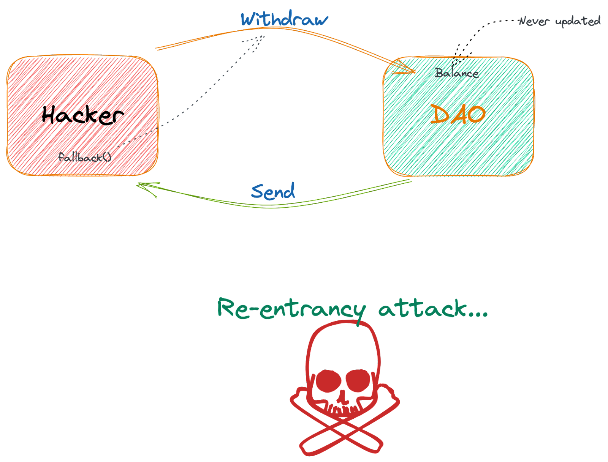
RE-ENTRANCY
Developers can also use static analysis tools and code reviews to identify potential re-entrancy vulnerabilities before deploying a contract.
Examples of successful re-entrancy attacks include the DAO hack in 2016 and the King of the Ether Throne game hack in 2018.

Slide 21
Transaction Ordering Dependency
A Transaction-Ordering Attack is a race condition attack
Transaction ordering dependency can occur when a contract modifies its own state during the execution of a transaction, and that state modification affects the behavior of subsequent transactions
If the order of transactions within a block is not deterministic, an attacker can exploit this vulnerability by manipulating the order in which their transactions are included in the block to achieve a desired outcome.

Slide 22
Transaction Ordering Dependency
The buyer of the digital asset will call the buy() function, to set a purchase at the price specified in the storage variable, with a starting price=50.
The contract owner will call setPrice() and update the price storage variable to price=100.
The contract owner will send the transaction with a higher gas fee.The contract owner’s transaction will be mined first, updating the state of the contract due to the higher gas fee.
4. The buyers transaction gets mined soon after, but now the buy() function will be using the new updated price=100.

Slide 23
Timestamp Dependency
It arises when a contract's behavior or logic depends on the timestamp value of the block in which it is included.
The timestamp value is a piece of data included in every block on the Ethereum blockchain that records the time at which the block was mined.
Smart contracts can use this value to implement time-based functionality, such as time-locked transactions or reward distributions.
However, if a contract's logic or behavior depends too heavily on the timestamp value, it can create a vulnerability. An attacker can exploit this vulnerability by manipulating the timestamp value, either by mining a new block with an earlier or later timestamp, or by sending a transaction with a manipulated timestamp.

Slide 24
Freezing Ether
It occurs when the smart contract allows an attacker to lock or freeze the ether that has been sent to the contract.
The vulnerability can occur due to a flaw in the smart contract's code, which can allow an attacker to trigger the freezing of the ether.
Once the ether is frozen, it cannot be transferred or accessed by anyone, including the contract owner.
This vulnerability can have serious consequences for the contract's users, as it can result in the loss of their funds.
In some cases, it can also affect the stability of the Ethereum network as a whole.
To prevent this vulnerability, it is important for smart contract developers to thoroughly test their code and conduct a comprehensive security audit.

Slide 25
Self-Destruct
The term "Self Destruct vulnerability" describes the potential for a contract to be erased or destroyed without the necessary validation or protections.
With the self-destruct opcode in Ethereum, a smart contract may be "self-destructed" or destroyed.
When a contract self- destructs, all its code and data are deleted from the blockchain and any money that was left in its balance is sent to a specified address.
When a contract uses the selfdestruct opcode without properly verifying the target address or ensuring that all essential data and money have been transmitted or properly accounted for, the self-destruct vulnerability may be present.
Data and money may be permanently lost if a contract self- destructs without adequate validation or protections.

Slide 26
Integer Overflow/Underflow
When an arithmetic operation is carried out that calls for a fixed size variable to store data outside the bounds of the variable data type, an integer overflow or underflow takes place.
In Solidity, signed integers are represented with “int” and unsigned integers are represented with “uint”.
When the outcome of an arithmetic operation exceeds the maximum value that may be stored in the data type, this is known as an integer overflow.
When the outcome of an arithmetic operation is less than the lowest value that may be stored in the data type, it is known as an integer underflow.
To prevent this vulnerability, mathematical libraries should be used instead of standard arithmetic operations.

Slide 27
TOOLS

Slide 28

Manticore
Manticore is an open-source tool that allows developers and security researchers to analyze smart contracts and identify potential vulnerabilities or bugs.
Symbolic execution is a technique that involves analyzing a program's execution paths without actually executing the program.
It works by representing the program's input values and program state as symbolic expressions, and then using constraint solving techniques to explore all possible paths through the program.
Manticore uses symbolic execution to explore the execution paths of smart contracts and identify potential vulnerabilities.

Slide 29
Manticore
It can be used to identify common vulnerabilities such as integer overflow, underflow, reentrancy, and other logic errors. Manticore has several features that make it useful for smart contract analysis.
It includes a Python-based API for creating custom analysis tools, a built-in Ethereum Virtual Machine (EVM) emulator, and support for multiple Ethereum contract languages, including Solidity and Vyper.
In addition to its core functionality, Manticore also includes several built-in analysis tools, such as a symbolic transaction generator, a contract coverage analyzer, and a vulnerability detector.
These tools can help developers and security researchers to quickly identify potential issues in their smart contracts and take steps to address them.

Slide 30

Remix
Remix is a free and open-source web platform for creating and analysing Ethereum smart contracts.
It gives programmers a simple interface for creating, testing, and deploying smart contracts on the Ethereum blockchain.
One of Remix's standout features is its analysis tool, which enables programmers to find possible security holes and other problems in their smart contracts.
Static examination of the contract's code by the analysis tool looks for flaws including re-entrancy attacks, integer overflows, and uncontrolled external calls.

Slide 31
Remix
A built-in debugger in Remix enables developers to go through the code for their smart contracts line by line and check the values of variables and other data structures as they go.
Debugging complicated contracts and finding possible flaws or unexpected behaviour can both benefit greatly from this.
Remix offers a variety of additional capabilities for Ethereum development in addition to its analysis and debugging tools, such as a contract deployment interface, a built-in Solidity compiler, and connection with well-known Ethereum wallets like MetaMask.
Remix is a robust and adaptable tool that is frequently used by developers in the Ethereum community for the building and analysis of Ethereum smart contracts.

Slide 32
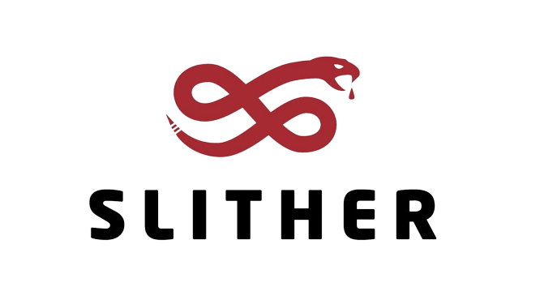
Slither
Slither is a static analysis tool for smart contracts on the Ethereum blockchain.
It helps developers and auditors to identify potential security vulnerabilities in smart contracts before they are deployed on the blockchain.
Slither uses a set of predefined rules to analyze the code of a smart contract and provides a detailed report of any potential vulnerabilities found.
Some of the issues it can detect include reentrancy attacks, integer overflows and underflows, access control vulnerabilities, and potential gas limits.

Slide 33
Slither
Slither supports multiple smart contract programming languages, including Solidity and Vyper, and can be integrated into popular development environments like Remix, VSCode, and IntelliJ IDEA.
Using Slither as part of a comprehensive security audit process can help ensure that smart contracts are secure and reliable, reducing the risk of smart contract hacks and exploits.

Slide 34
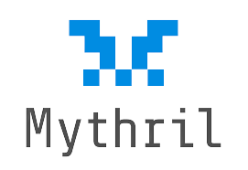
Mythril
Mythril is another popular static analysis tool for Ethereum smart contracts.
Like Slither, it is used to identify potential security vulnerabilities in smart contracts before they are deployed on the blockchain.
Mythril uses symbolic execution, a technique that explores all possible execution paths of a smart contract to identify potential issues.
It also uses several other analysis techniques, such as data flow analysis, control flow analysis, and taint analysis.
Mythril is able to detect a wide range of vulnerabilities, including reentrancy attacks, integer overflows and underflows, authorization and authentication issues, and gas-related issues.

Slide 35
Mythril
It also has a feature called "Mythril Platform," which enables users to automatically detect and exploit vulnerabilities in smart contracts.
Mythril can be used with various smart contract programming languages, including Solidity, Vyper, and LLL.
It can also be integrated with development environments like Remix and Truffle, making it easier for developers and auditors to use.
Using Mythril as part of a comprehensive security audit process can help ensure that smart contracts are secure and reliable, reducing the risk of smart contract hacks and exploits.

Slide 36
Contract Fuzzer
Contract Fuzzer is a tool for testing the robustness and security of Ethereum smart contracts.
It helps developers and auditors identify potential vulnerabilities in smart contracts by generating a large number of randomized inputs and testing how the contract responds to them.
Contract Fuzzer uses a combination of symbolic execution and mutation testing to generate random inputs that are likely to trigger edge cases and error conditions.
It then monitors the behavior of the contract to identify any unexpected or undesirable outcomes.
Contract Fuzzer is able to detect a wide range of vulnerabilities, including integer overflows and underflows, reentrancy attacks, and other types of unexpected behavior.

Slide 37
Contract Fuzzer
It can also be used to test the performance and scalability of smart contracts under various conditions.
Using Contract Fuzzer as part of a comprehensive security audit process can help ensure that smart contracts are robust and secure.
It can help identify potential issues before they are exploited, reducing the risk of smart contract hacks and exploits.
Contract Fuzzer is compatible with various smart contract programming languages, including Solidity and Vyper. It can be used as a standalone tool or integrated with other development environments like Remix and Truffle.

Slide 38
EXPLOITATION PoC

Slide 39
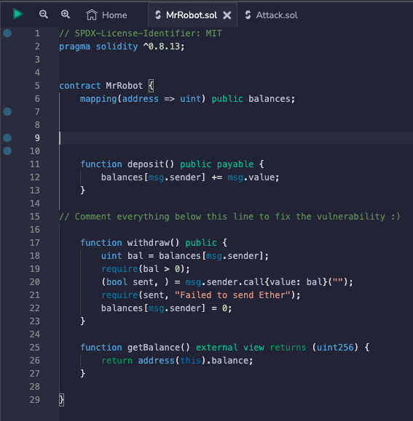
Problems
The deposit() function will deposit the funds.
The withdraw() function is to withdraw the deposited money after checking the balance and fulfilling requirement of balance greater than 0.
If this condition holds true it will transfer the funds and update the balance.

Slide 40
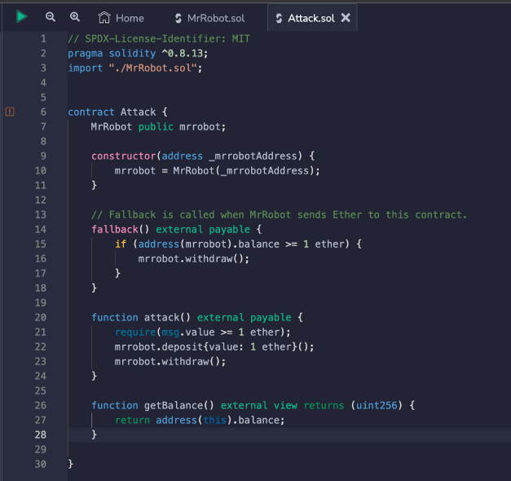
Problems
In case of an attack, the attacker will point the recipient as another contract so attacker will deposit ether to contract and when deposit() is trying to add ether to that another contract, fallback() function gets executed which checks the balance and it makes recursive call to withdraw() function and since balance doesn’t gets updated it drains all the funds from the original contract including the one attacker has deposited.

Slide 41
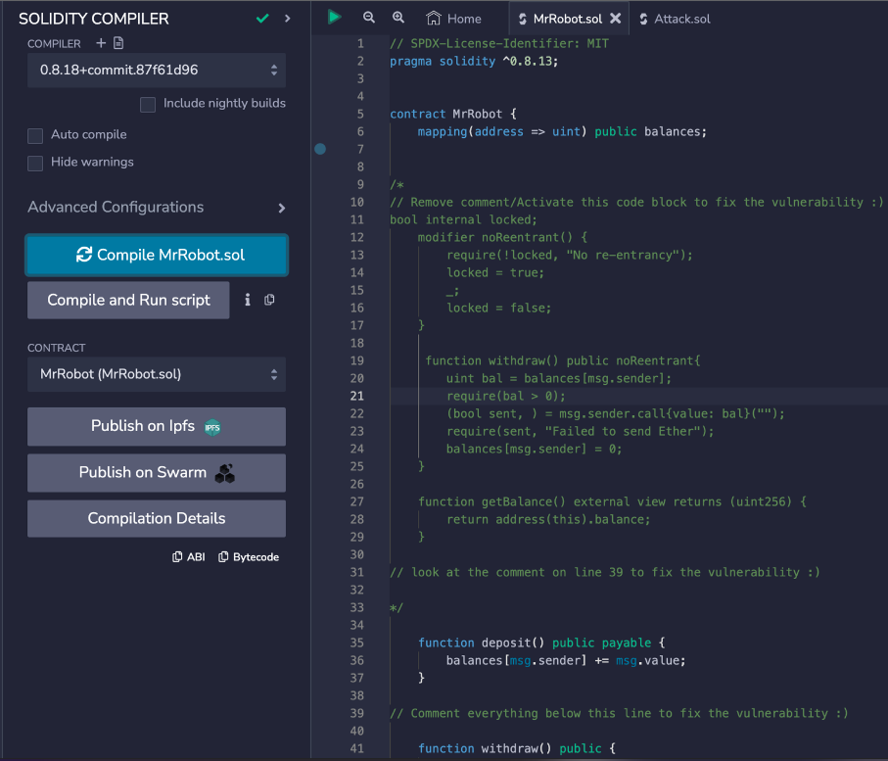
Step 1
Here, we analysed and deployed the contract using Remix IDE. The first two files we made are called MrRobot.sol and Attack.sol.
As was already mentioned, the attack contract contains the exploit code, and the main contract, MrRobot, is vulnerable to re-entrancy attacks. Secondly, We are going to compile these both contract.

Slide 42
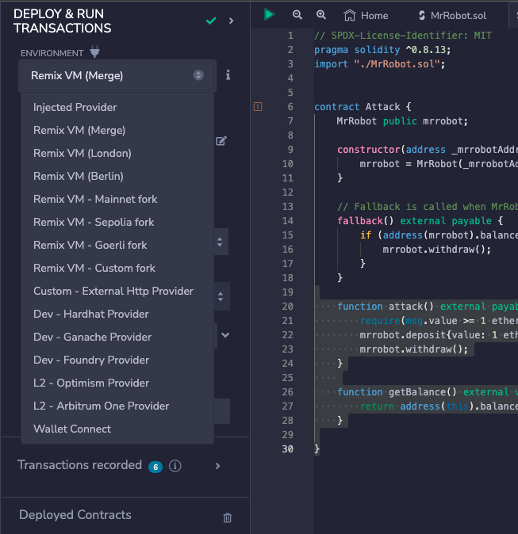
Step 2
The environment must then be selected. We have three options: our personal wallet, a local instance, or a virtual machine provided by "Remix."
Now, we'll deploy our contract using a virtual machine provided by "Remix." As soon as we select a virtual machine, we will be given a various wallet addresses with 100 ether in it so that we can test out different functionalities.

Slide 43
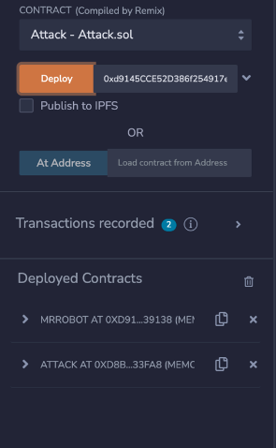
Step 3
Also, once all of these procedures have been completed, we will deploy our "Mr. Robot" contract by selecting the "Deploy" button.
Once the Mr. Robot contract has been successfully deployed, it will generate an address that we will use to deploy the "Attack" contract.
It is mandatory to use MrRobot contract address to pass while deploying Attack contract. We have successfully deployed both of our contracts up until this point.

Slide 44
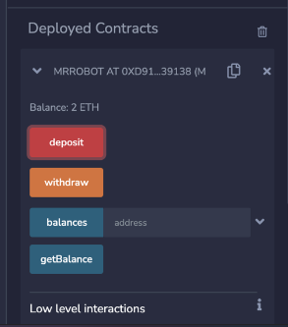
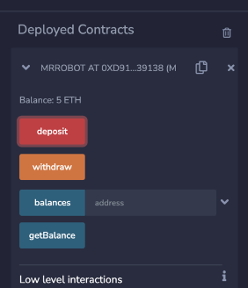
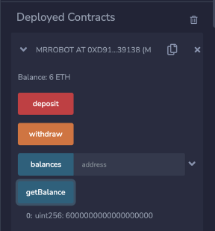
Step 4
Now we're going to use three different wallet addresses to deposit ether into the Mr. Robot contract.
We're going to use three different wallets to deposit 2, 3, 1 ether sequentially.
This will bring the total amount of ether in the contract up to 6. Everything appears to be operating normally up until this point.

Slide 45
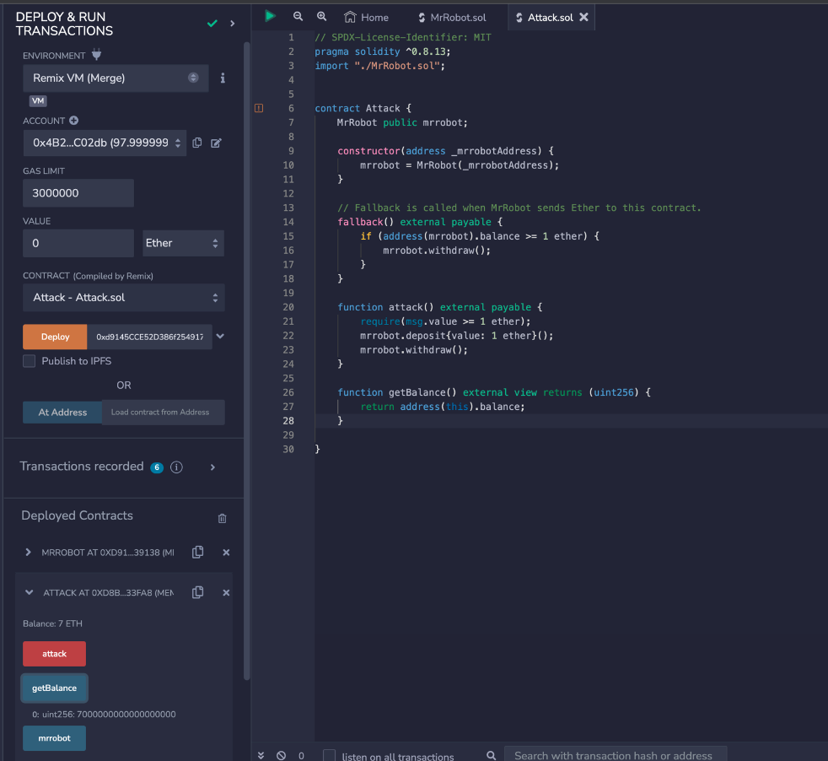
Step 5
At this last step, the attacker will send one ether. But due to the exploit code, he will ended up draining all the ether from the contract.

Slide 46
Bonus

Slide 47


Bug Bounty Programs
Hackenproof
Immunefi

Slide 48
Thank You

